Slide 1
Azure Data Factory

Slide 2
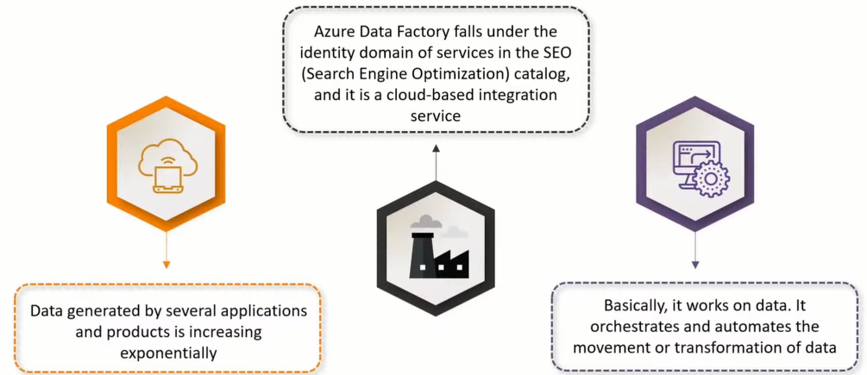
Azure Data Factory

Slide 3

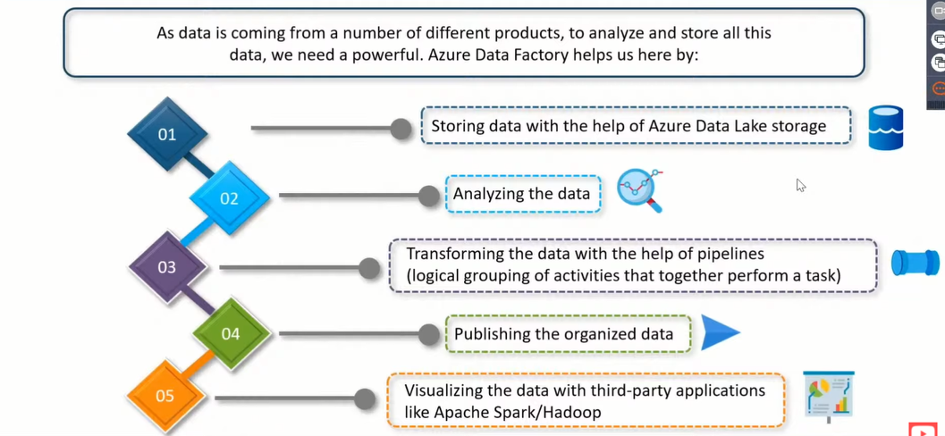

Azure Data Factory

Slide 4
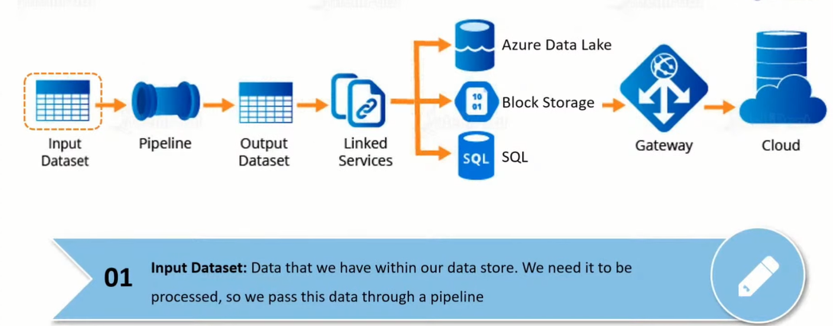
Flow Process of Data Factory

Slide 5
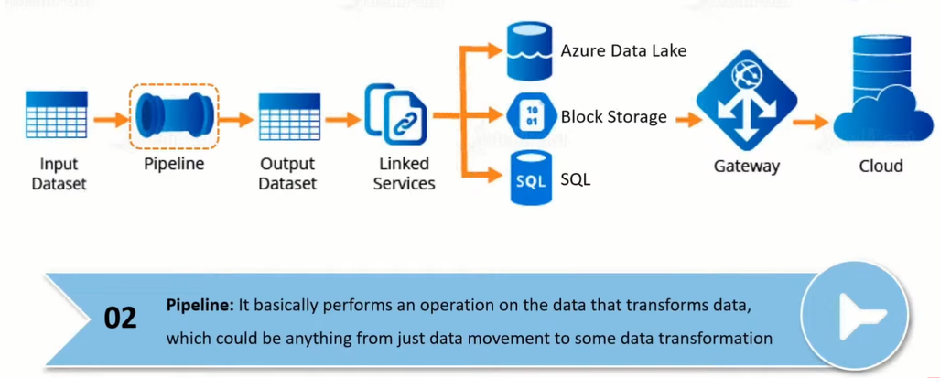
Flow Process of Data Factory

Slide 6
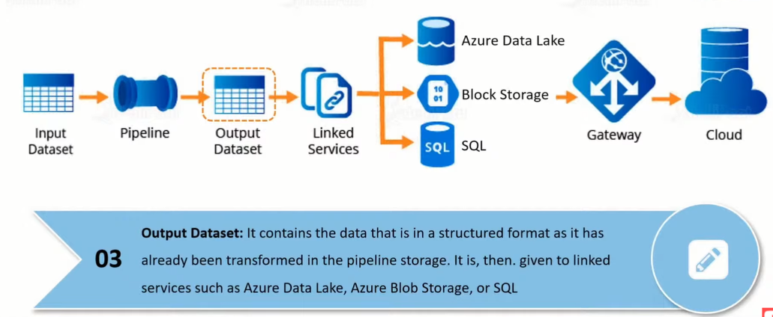

Flow Process of Data Factory

Slide 7
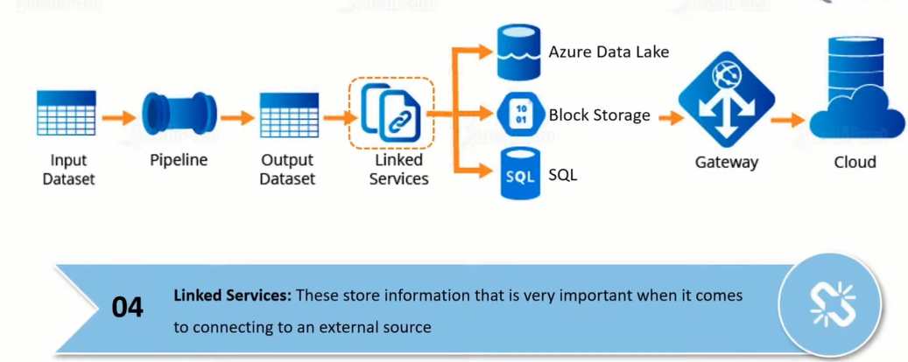
Flow Process of Data Factory

Slide 8

Flow Process of Data Factory

Slide 9
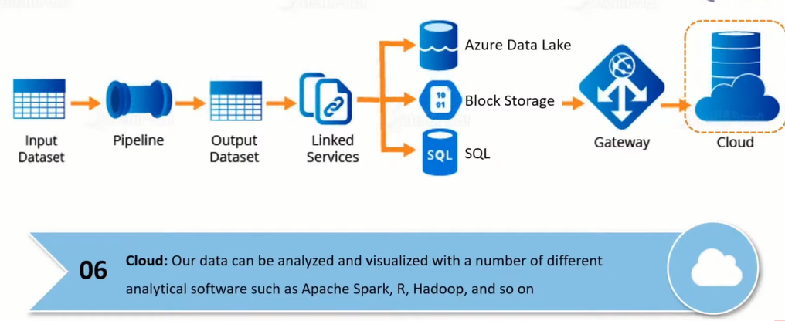
Flow Process of Data Factory

Slide 10
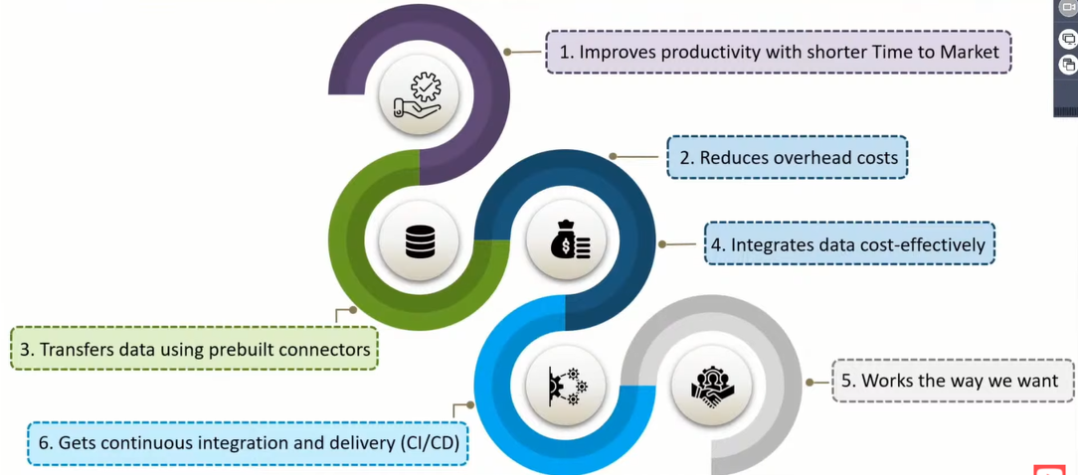


Why Azure Data Factory..

Slide 11
Demo

Slide 12
Azure Data Bricks

Slide 13
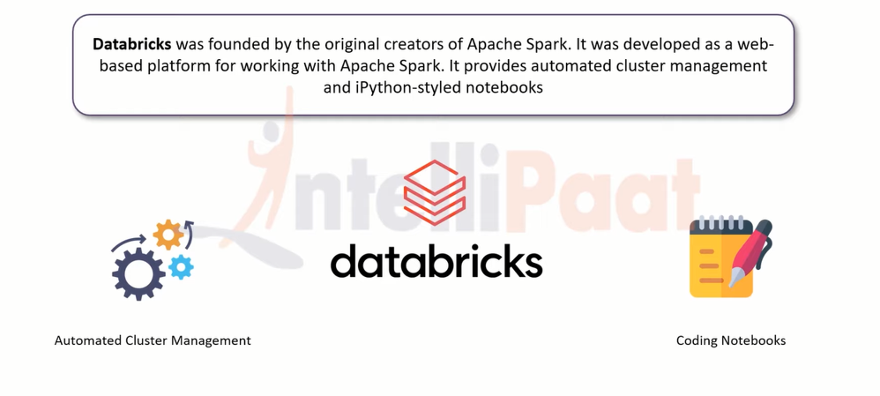

What is Azure Data bricks

Slide 14
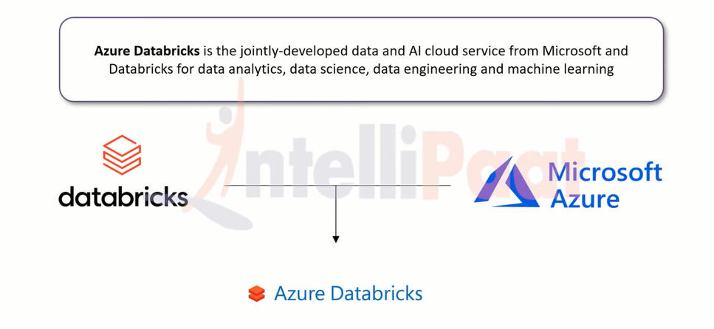

What is Azure Data bricks

Slide 15
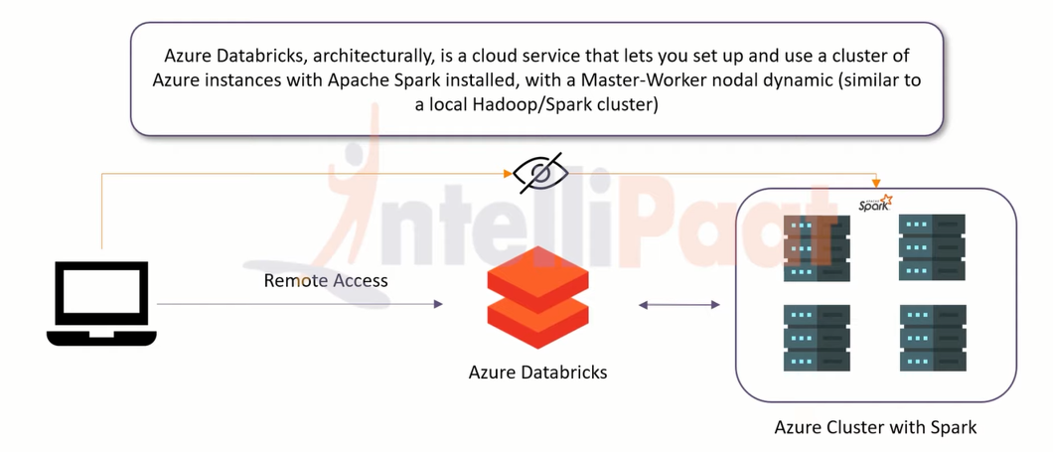

What is Azure Data bricks

Slide 16
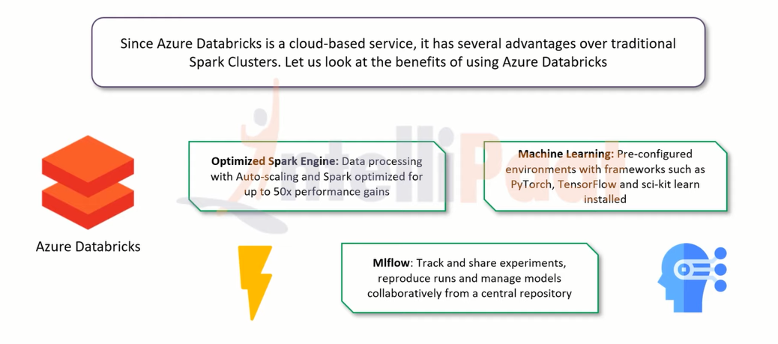

Why Azure Data bricks…

Slide 17
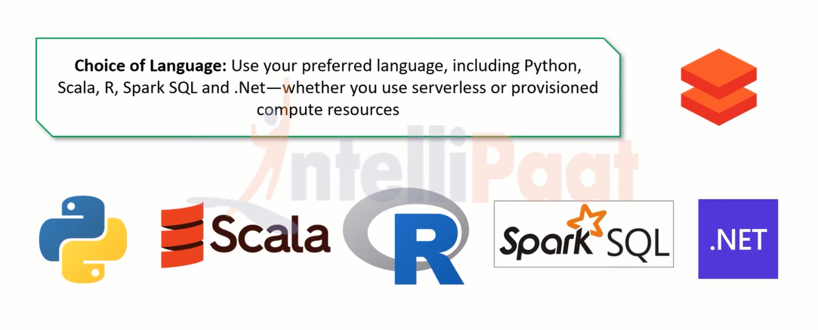

Why Azure Data bricks…

Slide 18
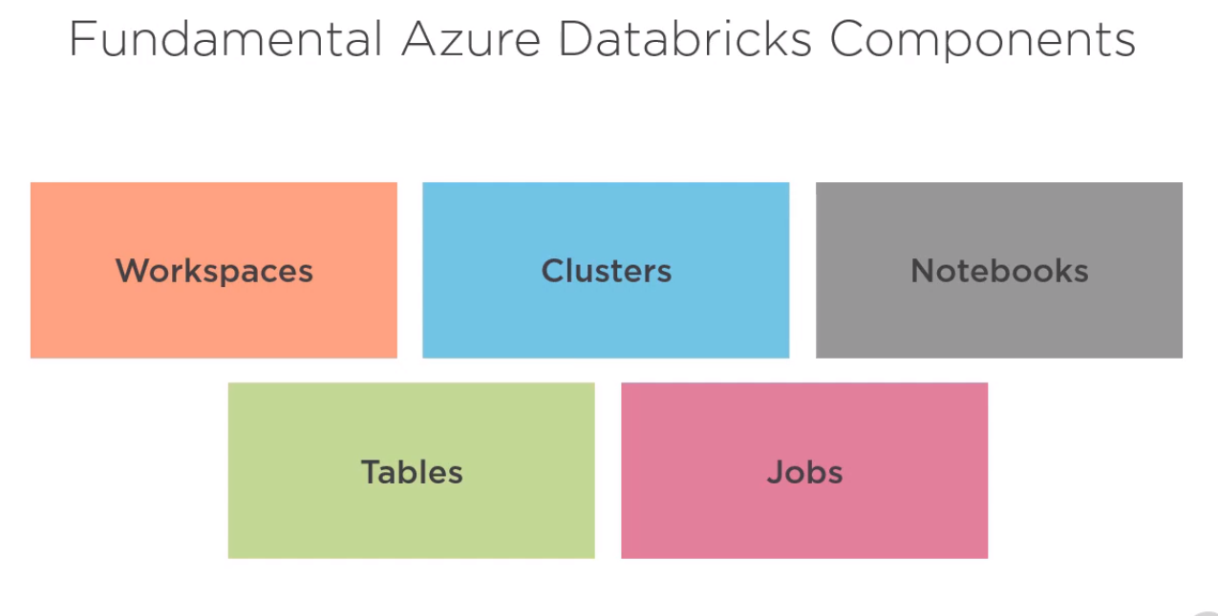

Slide 19
Databricks concepts: This section introduces the set of fundamental concepts you need to understand in order to use Databricks effectively.
Workspace
The workspace is an environment for accessing all of your Databricks assets. The workspace organizes objects (notebooks, libraries, dashboards, and experiments) into folders and provides access to data objects and computational resources.
Objects contained in the Databricks workspace folders.
Notebook
A web-based interface to documents that contain runnable commands, visualizations, and narrative text.
Dashboard
An interface that provides organized access to visualizations.
Library
A package of code available to the notebook or job running on your cluster. Databricks runtimes include many libraries and you can add your own.
Experiment
A collection of MLflow runs for training a machine learning model.

Slide 20
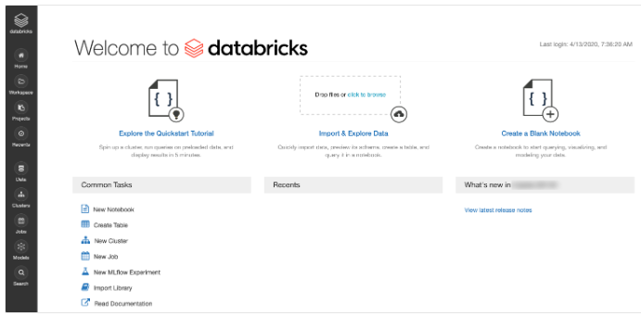
Interface: This section describes the interfaces that Databricks supports for accessing your assets: UI, API, and command-line (CLI).
UI
The Databricks UI provides an easy-to-use graphical interface to workspace folders and their contained objects, data objects, and computational resources.

Slide 21
REST API
There are two versions of the REST API: REST API 2.0 and REST API 1.2. The REST API 2.0 supports most of the functionality of the REST API 1.2, as well as additional functionality and is preferred.
CLI
An open source project hosted on GitHub. The CLI is built on top of the REST API 2.0.
Data management
This section describes the objects that hold the data on which you perform analytics and feed into machine learning algorithms.
Databricks File System (DBFS)
A filesystem abstraction layer over a blob store. It contains directories, which can contain files (data files, libraries, and images), and other directories. DBFS is automatically populated with some datasets that you can use to learn Databricks.

Slide 22
Database
A collection of information that is organized so that it can be easily accessed, managed, and updated.
Table
A representation of structured data. You query tables with Apache Spark SQL and Apache Spark APIs.
Metastore
The component that stores all the structure information of the various tables and partitions in the data warehouse including column and column type information, the serializers and deserializers necessary to read and write data, and the corresponding files where the data is stored. Every Databricks deployment has a central Hive metastore accessible by all clusters to persist table metadata. You also have the option to use an existing external Hive metastore.

Slide 23
Computation management
This section describes concepts that you need to know to run computations in Databricks.
Cluster
A set of computation resources and configurations on which you run notebooks and jobs. There are two types of clusters: all-purpose and job.
You create an all-purpose cluster using the UI, CLI, or REST API. You can manually terminate and restart an all-purpose cluster. Multiple users can share such clusters to do collaborative interactive analysis.
The Databricks job scheduler creates a job cluster when you run a job on a new job cluster and terminates the cluster when the job is complete. You cannot restart an job cluster.
User
A unique individual who has access to the system.
Group
A collection of users.

Slide 24
Job
A non-interactive mechanism for running a notebook or library either immediately or on a scheduled basis.
Workload
Databricks identifies two types of workloads subject to different pricing schemes: data engineering (job) and data analytics (all-purpose).
Data engineering
An (automated) workload runs on a job cluster which the Databricks job scheduler creates for each workload.
Data analytics
An (interactive) workload runs on an all-purpose cluster. Interactive workloads typically run commands within a Databricks notebook. However, running a job on an existing job cluster is also treated as an interactive workload.
Execution context
The state for a REPL environment for each supported programming language. The languages supported are Python, R, Scala, and SQL.

Slide 25
Demo

